Slide 1
DDCA PROJECT
Design of a 4-bit
Binary-to-Decimal
Conversion and Display
System Using Logic Gates
Subject: DDCA
Team Members:
2620030061 SAI KIRAN KANAPARTHI
2620030113 MANNAVA NISHITHA
2620030052 DUPPALA BHUVANA
2620030118 HARSHITHA REDDY

Slide 2
A 4-bit word can encode sixteen decimal values
The task is to make the encoded value readable as a decimal result.
Problem statement
Four bits represent the integers 0 through 15.
The circuit translates A B C D into decimal-place signals.
Boolean logic realizes every output directly from the inputs.
Logisim is used to simulate and verify the design.
2

Slide 3

Inputs are decoded into tens and ones outputs
The working principle uses weighted binary terms and decimal display logic.
Objectives
Accept a 4-bit input A, B, C, D.
Generate its decimal equivalent (0–15).
Implement expressions using logic gates.
Verify combinations in Logisim.

Slide 4
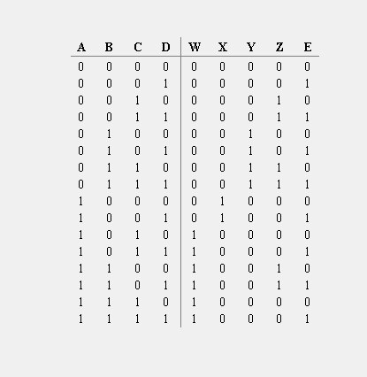
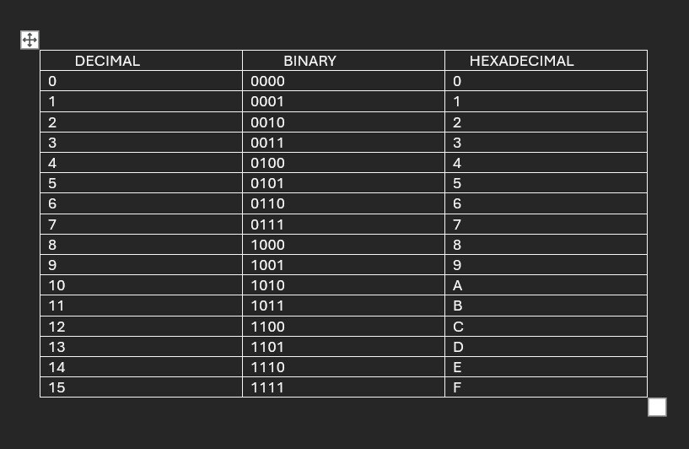
Truth table defines the output logic
The tens digit is active only for inputs 10–15; the ones digit follows the remaining value.
4

Slide 5
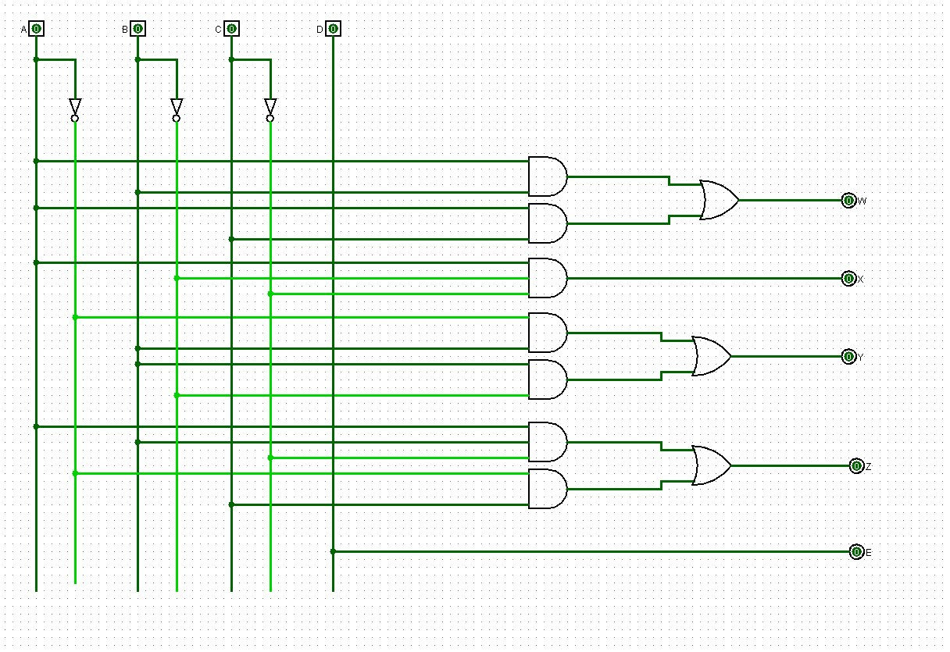
Logisim-style circuit verifies representative conversions
Each test vector produces the expected decimal result.
Simulation test cases
0011₂
→
3₁₀
0111₂
→
7₁₀
1010₂
→
10₁₀
1111₂
→
15₁₀
Outputs verified for all listed test cases.
5

Slide 6
The design connects Boolean theory to a working digital system
A compact 4-bit decoder demonstrates core DDCA Module 1 concepts.
Conclusion
0111
Designed a 4-bit binary-to-decimal conversion system.
Derived and implemented the required logic expressions.
Decimal output
7
Tested representative input combinations in Logisim.
Demonstrates practical use of DDCA Module 1 concepts.
Thank you
6

